Slide 1
Accessing Hardware registers
and Using CMSYS
1
1
1
Copyright @ 2008 Real Time College
Copyright @ 2008 Real Time College
Notes:
Developed by Benny Cohen bennyc1313@walla.co.il
1

Slide 2
Accessing Hardware registers
Hardware Registers and its difference from RAM registers
Accessing the HW registers in C language
Using pointers.
Direct access using the addresses and data types.
Working with HW registers using the C data types
Volatile keyword.
Single type data types.
Using data structs to access the HW registers.
Aligned and not Aligned data structs in C.
Changing the bit values in HW register by using Bit Masks and Bitwise Operations
Class Exercise

Slide 3
Hardware Registers and its difference from RAM registers.
Hardware registers are individual entities – each one issues a specific operation on the device on which it resides.
Such an entity consumes up to a WORD.
A word consists of 32 bits.
This entity is generally referred to by the CPU as a memory mapped address on the board address space.
UART0 line control register is accessed by referring to address 0x50000000.
The value which is written to this entity may be used as an index to another entity on the device.
3
3
Copyright @ 2008 Real Time College

Slide 4
HW Registers vs. RAM locations
4
4
Copyright @ 2008 Real Time College
Both HW registers and RAM locations are generally accessed in a similar way.
However, there are differences:
RAM location contains the last value that has been written to it.
Write access – modifies the contents.
Read access – returns the contents without modification.
Hardware registers issue specific operation according to the way by which they were accessed.
Some of these registers can not be modified by program.
Some registers may not contain the value written to them.
Some registers are modified as a result of read operation.
In Interrupt handling registers:
Writing 0 to a specific bit location does not change the value in this location.
Writing 1 to a specific bit location resets the value in this location to 0.
Operation on one register may have an impact on the contents of some other register.
The behavior is defined based on the specification of the Hardware component on which they reside.

Slide 5
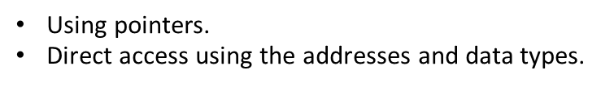
Accessing the HW registers in C language

Slide 6
Accessing the HW registers using Pointers
To read/write to specific register address we create pointer to data type of the register we want to access.
We assign the address of the register to a pointer.
We dereference the pointer to read/write from the register.
Example:
UINT32 *GPIOadd;
GPIOadd = 0x5AF3FT45;
*GPIOadd = (1<<5);

Slide 7
Accessing the HW registers using by data type and address
To read/write to specific register address we cast a data type of the register we want to access.(UINT32*)
We write the address of the register on a right side. .((UINT32*) 0x5AF3FT45)
We use dereference to read/write from the register. *((UINT32*) 0x5AF3FT45)
Example:
UINT32 *GPIOadd;
GPIOadd = 0x5AF3FT45;
*GPIOadd = (1<<5); same as *((UINT32*) 0x5AF3FT45)= (1<<5);

Slide 8
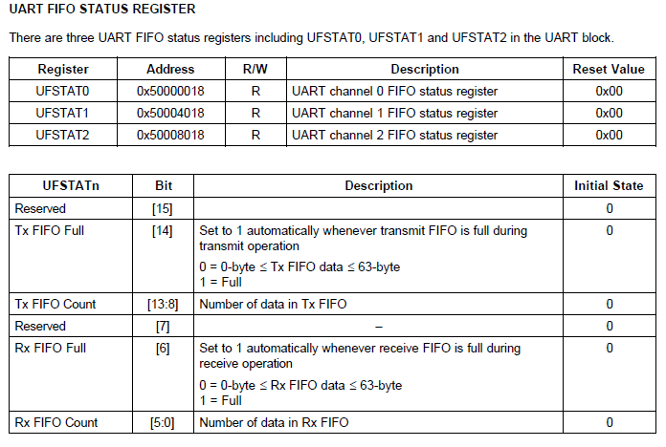
Example : HW Registers in C language.
Volatile? What is it?
#define UART_UFSTAT0 (volatile unsigned long *)0x50000018
#define UART_UFSTAT1 (volatile unsigned long *)0x50004018
#define UART_UFSTAT2 (volatile unsigned long *)0x50008018
#define UART_UFSTAT0_TX_FIFO_FULL_BIT 0x00004000L
#define UART_UFSTAT0_RX_FIFO_FULL_BIT 0x00000040L
8
8
Copyright @ 2008 Real Time College

Slide 9
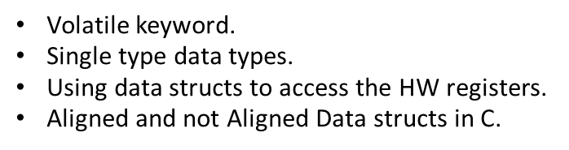
Working with HW registers using the C data types

Slide 10
Volatile keyword
During the compilation process compile use the process called optimization.
The purpose of the optimization is make the output program smaller and faster.
Usually we benefit from this process but we need to know how to control it.
The compiler assumes that by default that the hardware register will not change unless he change its value.
As we saw earlier this is not the case in embedded systems.
The value of the register can change by peripheral devices without the CPU changing it value.
To tell the compiler that the value of specific memory address can be changed from outside we need to use volatile word before the data type declaration.
Example:
volatile UINT32 *RegAdd = 0x5AF3FT45;

Slide 11
Volatile keyword – cont.
#define UART_UFSTAT0 (unsigned long *)0x50000018
#define UART_UFSTAT1 (unsigned long *)0x50004018
#define UART_UFSTAT2 (unsigned long *)0x50008018
Bad example
#define UART_UFSTAT0_TX_FIFO_FULL_BIT 0x00004000L
#define UART_UFSTAT0_RX_FIFO_FULL_BIT 0x00000040L
while (*(UART_UFSTAT0) & UART_UFSTAT0_TX_FIFO_FULL_BIT); /* Wait as long as bit 14 is set */
printf (“here we are\n”)
If the initial value at address 0x50000018 is 0x4000.
The code is optimized by the compiler according to the following rule:
If (*(UART_UFSTAT0) & UART_UFSTAT0_TX_FIFO_FULL_BIT){
while (1);
}
The HW resets bit 14, but the program doesn’t know it, since it doesn’t read this register any more.
So, the program will loop forever.
11
11
Copyright @ 2008 Real Time College

Slide 12
Volatile keyword – cont.
#define UART_UFSTAT0 (volatile unsigned long *)0x50000018
#define UART_UFSTAT1 (volatile unsigned long *)0x50004018
#define UART_UFSTAT2 (volatile unsigned long *)0x50008018
Good example
#define UART_UFSTAT0_TX_FIFO_FULL_BIT 0x00004000L
#define UART_UFSTAT0_RX_FIFO_FULL_BIT 0x00000040L
while (*(UART_UFSTAT0) & UART_UFSTAT0_TX_FIFO_FULL_BIT); /* Wait as long as bit 14 is set */
printf (“here we are\n”)
If the initial value at address 0x50000018 is 0x4000.
Compiler assumes that the value of the pointer may be changed by an external entity. So, it does not issue any optimizations on access to this register.
The HW resets bit 14, and the program will know it, since it polls on this register.
So, the program will print “here we are” immediately after bit 14 has been reset.
12
12
Copyright @ 2008 Real Time College

Slide 13
Single type data types
In Embedded its much easier to use data types that they size is already known like UINT32.
We know exactly that this data type representing unsigned integer and it size is 32 bits.
Other embedded data type examples:
UINT8;
UINT16;
UINT64;

Slide 14
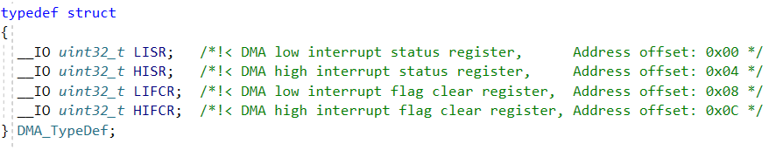
Using data structs to access the HW registers
Using structs data type to access HW register is very efficient.
We need only define the beginning of the struct and use the -> operator to access the members of the struct .
We can define each register by using the data type.
Example:

Slide 15
Aligned and not Aligned data structs in C
By default compiler use padding to pad the data members in structs.
This make structs unusable for embedded programing.
To prevent the padding we need to use #pragma(0) keyword before the struct.

Slide 16
Changing the Bit values in HW register using Masks and Bitwise Operations

Slide 17
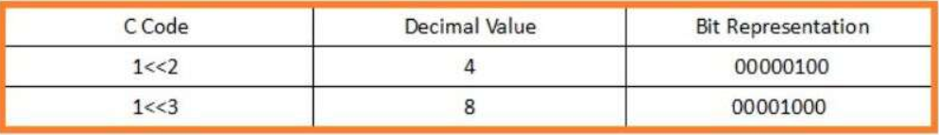
Creating bitwise mask
Bit Shift Operators
There are two bit shift operators in C: the left shift operator << and the right shift operator >>. These operators drive the bits in the left operand to be shifted left or right by the number of positions specified by the right operand. In short, an expression like a<<b will be evaluated as the binary representation of “a” will be shifted “b” times to the left, and the value is getting larger.

Slide 18
Bitwise Operations
There is four types of bitwise operations:
Setting a bit
Clearing a bit
Toggling a bit
Check a value of a bit

Slide 19
Setting a bit
To set a particular bit of a number, we use bitwise OR operator (|), it sets the bits – if the bit is not set, and if the bit is already set, bit’s status does not change.
Let suppose there is a number num and we want to set the Xth bit of it, then the following statement can be used to set Xth bit of num
num |= 1 << x;

Slide 20
Clearing a bit
To clear a particular bit of a number, we use bitwise AND operator (&), it clears the bit – if the bit is set, and if the bit is already cleared, bit’s status does not change.
Let suppose there is a number num and we want to clear the Xth bit of it, then the following statement can be used to clear Xth bit of num
num &= ~(1 << x);

Slide 21
Toggling a bit
To toggle a particular bit of a number, we can use bitwise XOR operator (^), it toggles the bit – it changes the status of the bit if the bit is set – it will be un-set, and if the bit is un-set – it will be set.
Let suppose there is a number num and we want to toggle the Xth bit of it, then the following statement can be used to toggle Xth bit of num
num ^= 1 << x;

Slide 22
Check a value of a bit
Bitwise AND Operator (&) is used to check whether a bit is SET (HIGH) or not SET (LOW) in C and C++ programming language.
Bitwise AND Operator (&) is a binary operator, which operates on two operands and checks the bits, it returns 1, if both bits are SET (HIGH) else returns 0.
Let suppose, you want to check Nth bit of a Number NUM, you can do the same by following this syntax:
A=(NUM & (1<<N))
Here, NUM is the number whose bit you want to check and N is the bit number, (1<<N) SET the particular bit at Nth position.
Example:
Statement (1<<3) returns 8 (in Binary: 0000 1000), see the binary 3rd (count from 0 to 7) bit is SET here.

Slide 23
HW registers – bitwise operations - examples
Set bits 4 and 20 of the register FOO_REG. Other bits should not be modified by program.
*((volatile unsigned long *)FOO_REG) |= 0x100010;
*((volatile unsigned long *)FOO_REG) = *(FOO_REG) | 0x100010;
*((volatile unsigned long *)FOO_REG) |= ((1 << 4) | (1 << 20));
*((volatile unsigned long *)FOO_REG) = *(FOO_REG) | (1 << 4) | (1 << 20);
Reset bits 4 and 20 of the register FOO_REG. Other bits should not be modified by program.
*((volatile unsigned long *)FOO_REG) &= ~0x100010;
*((volatile unsigned long *)FOO_REG) = *(FOO_REG) & ~0x100010;
*((volatile unsigned long *)FOO_REG) &= ~((1 << 4) | (1 << 20));
*((volatile unsigned long *)FOO_REG) = *(FOO_REG) & ~( (1 << 4) | (1 << 20));
Wait until either bit 4 or bit 20 of the register FOO_REG is set. Other bits have no meaning.
while (!(*(volatile unsigned long *)FOO_REG) & 0x100010));
23
23
Copyright @ 2008 Real Time College

Slide 24
Class/HW exercise HW registers
24
24
Copyright @ 2008 Real Time College
The STM32 board:
Find the control register address of GPIOA.
Print the register values.
Set bites 3 and 8 of the register to high.
Set bit 8 to low.
Toggle the value of the register 5.
After each step print the result.
Use the pointer and direct access method to access the register.

Slide 25
ARM CMSYS
What is Arm CMSYS and why it was created?
How Arm CMSYS is build?
Using the Arm CMSYS structs to access Peripheral data registers.
Class exercise.

Slide 26
What is Arm CMSYS and why it was created?
Every vendor uses it own way to access the HW registers. Some use Bitfield some use bitwise operations other use unions and Bit banding and it is very hard when you move from one MCU to another to learn a new method that the vendor use to asses the HW.
To solve this problem ARM introduced the CMSIS standart, that define how the HW access should be done and introduce new standards for a HW interaction.
Today most of the vendors follow this standard and they libraryes are CMSIS compatible.

Slide 27
How Arm CMSYS Core is build?
CMSIS-Core (Cortex-M) implements the basic run-time system for a Cortex-M device and gives the user access to the processor core and the device peripherals. In detail it defines:
Hardware Abstraction Layer (HAL) for Cortex-M processor registers with standardized definitions for the SysTick, NVIC, System Control Block registers, MPU registers, FPU registers, and core access functions.
System exception names to interface to system exceptions without having compatibility issues.
Methods to organize header files that makes it easy to learn new Cortex-M microcontroller products and improve software portability. This includes naming conventions for device-specific interrupts.
Methods for system initialization to be used by each MCU vendor. For example, the standardized SystemInit() function is essential for configuring the clock system of the device.
Intrinsic functions used to generate CPU instructions that are not supported by standard C functions.
A variable to determine the system clock frequency which simplifies the setup the SysTick timer.

Slide 28
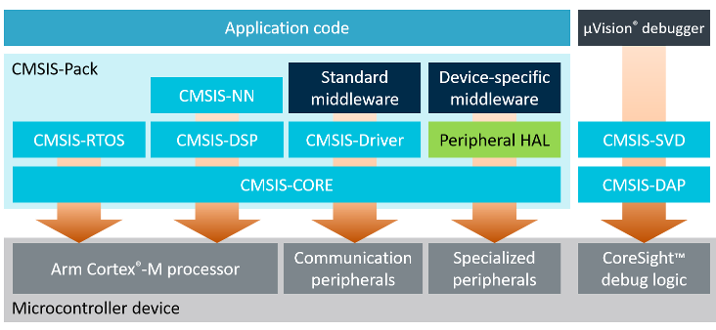
CMSIS Structure

Slide 29
CMSIS-Core Device Templates
Arm supplies CMSIS-Core device template files for the all supported Cortex-M processors and various compiler vendors.
These CMSIS-Core device template files include the following:
Register names of the Core Peripherals and names of the Core Exception Vectors.
Functions to access core peripherals, special CPU instructions and SIMD instructions (for Cortex-M4 and Cortex-M7)
Generic startup code and system configuration code.
The detailed file structure of the CMSIS-Core device templates is shown in the following picture.

Slide 30
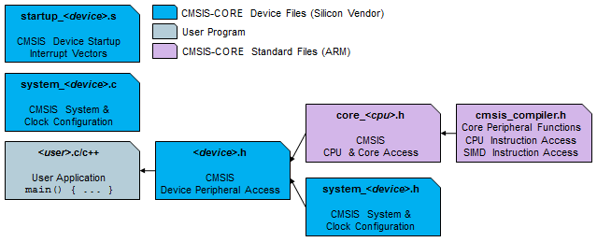
CMSIS-Core File Structure

Slide 31
Using the Arm CMSYS structs to access Peripheral data registers.
Lets understand how the stm32f446xx.h file made by CMSIS standards works.
The File contain the following information:
Peripheral_interrupt_number_definition
Peripheral_registers_structures
Peripheral_memory_map
Peripheral_declaration
Peripheral_Registers_Bits_Definition
We going to focus on the topics marked in red.

Slide 32
Peripheral Registers Structures
Defines the structure of each prereferral registers using impropriate data type.
If we compare to register position in a reference manual we can see that the struct completely copies the actual registers placement in a reference manual.

Slide 33
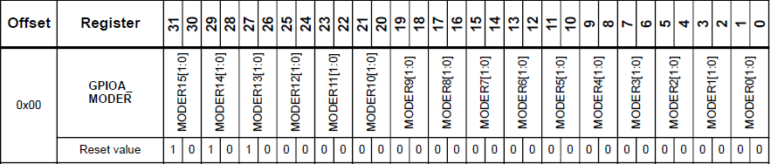

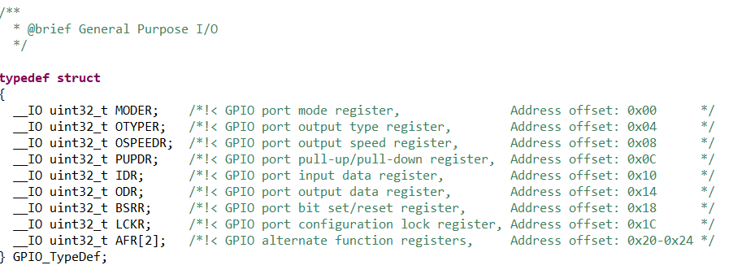
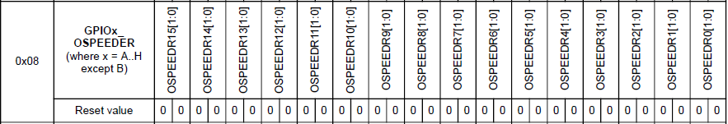
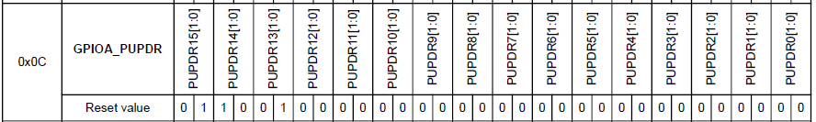
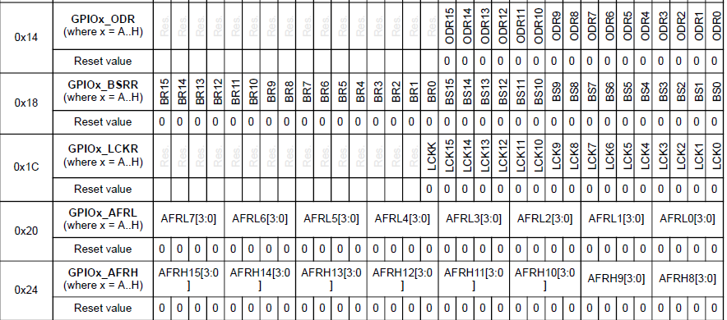
Example:

Slide 34
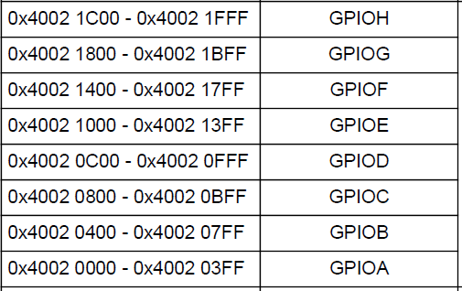
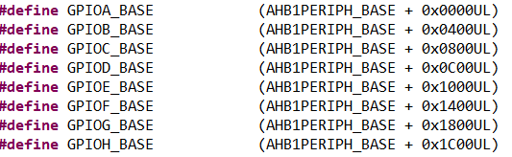
Peripheral Memory Map
Contain the base address of each peripheral corresponding to a reference manual
Example:

Slide 35
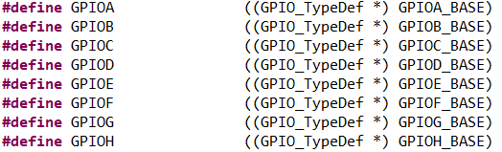
Peripheral Declaration
Contain the base address and data type ready to use to access the HW registers using the -> operator.
Example:

Slide 36
CMSYS Class/HW exercise
Using CMSIS peripheral declaration access the GPIOA control register and perform on it all the action we did in a previous chapter.

